Slide 1
NRI
FNIO
Mail Order Business

Slide 2
Who is a Non-Resident Indian ?
A citizen of India and
Temporarily residing in another country and
Having a valid passport issued by Government of India
Who is a Foreign National of Indian Origin ?
A foreign citizen who at any time held an Indian Passport or
he or either of his parents or any of his grand parents was a citizen of India by virtue of the constitution of India or Citizenship Act,1955.

Slide 3
Insurance to FNIOs
Insurance to NRIs
On their visit to India: Insurance cover is canvassed in India and all formalities regarding filling in the proposal forms, obtaining medical examination report /special medical reports and Moral Hazard Report are completed during their stay in India.
Mail Order Business: All formalities are completed in their present country of residence.
On their visit to India: All formalities are completed in India.
Mail Order Business: All formalities are completed in their present country of residence as per circular 314

Slide 4
Insurance to NRIs and FNIOs
The countries are classified into five Residence groups
Circular Ref : U&R/145/2016 dated 23.11.2016
The classification of countries is on the basis of geopolitical/economic scenario
Residence risk is in decreasing order from Group I to Group V

Slide 5
Residence Group I
NRIs and FNIOs allowed insurance with restrictions
Country Name | Country Name | Country Name
Afghanistan | Iran | Palestine
Burundi | Iraq | Somalia
Chad | Israel – West Bank, Gaza, Jerusalem | Sudan
Chechen Republic | Liberia | Western Sahara
Democratic Republic of the Congo (Zaire) | North Korea | Yemen
Haiti | Pakistan | Zimbabwe

Slide 6
Residence Group I
Total Insurance Allowed | 10 Lacs
Plans Allowed | Endowment type Single premium plans – 916, 917 Plan 865 Dhan Sanchay (SP Option C)
Maximum Term Allowed | 15 Years
Pension Plans | Sgl prem-Without life cover to NRIs only without limit
Residence Extra | Nil

Slide 7
Residence Group II
NRIs and FNIOs allowed insurance with restrictions
Country Name | Country Name | Country Name
Angola | Ethiopia | Myanmar (Burma)
Armenia( NagornoKarabakh) | Guatemala | Nepal (South Terrai Region, Birgank, Janakpura, Rangeli)
Azerbaijan (others) | Guinea | Niue
Bangladesh ( Rangpur (district), Jhanjali, Machanganj, Mymensingh, Naogaon, Rohanpur, Rajshahi(district), Ishurdi, Khulana(district), Sylhet(district) and Chittagong (district) | Guinea Bissau | Papua New Guinea
Burkina Faso | Honduras | Peru (Ayachuco, Apurimac, Cusco, Junin and Huancavelica regions, Ene Apurimac River Valley-VRAE)
Cameroon | Indonesia, (Aceh, Papua, Central Sulawesi Maluku, | Philippines (Mindanao, Sulu Archipelago, Zamboanga Peninsula) (Occupations other than Military, Security, Mineral Extraction &
Central African Republic | Ivory Coast | Russia (Chechnya, Dagestan, Ingushetia, Kabardino-Balkaria, Karachay-Cherkessia, North Ossetia)
Cote d Ivoire | Kyrgyzstan | Rwanda
Colombia | Madagascar (others) | Sierra Leone
Djibouti | Mali | Tajikistan
– Ecuador (Carchi, Sucumbios, Imbabura, Esmeraldas) | Montserrat | Togo
Equitorial Guinea -– Malabo | Morocco( Other) | Uzbekistan
Eritrea | Mozambique (Nampula, Manica, Sofala) | Venezuela – (Others)

Slide 8
Residence Group II
Total Insurance Allowed | 25 Lacs
Plans Allowed | Endowment type Single premium plans – 916, 917 etc Plan 865 Dhan Sanchay (SP Option C)
Maximum Term Allowed | 15 Years
Pension Plans | Sgl prem-Without life cover to NRIs only without limit
Residence Extra | Nil

Slide 9
Residence Group III
Group III – 7 countries
HIV test compulsory in 5 African countries
NRIs and FNIOs allowed insurance with restrictions
Country Name | Country Name | Country Name
Comoros (HIV) | Niger (HIV) | Turkmenistan
Lebanon
Nicaragua (HIV) | Nigeria (HIV) | Uganda (HIV)

Slide 10
Residence Group III
Total Insurance Allowed | 150 Lacs
Plans Allowed | All Plans except Pure Term Insurance. Pension plans without life cover to NRIs only
Riders | Only AB Rider Allowed
Residence Extra | Rs 3%0 (no Res extra for 916, 917, 865 - Option C with sgl prem with Max term 15 Years where ASA is lower than single premium paid & pension plans without life cover)

Slide 11
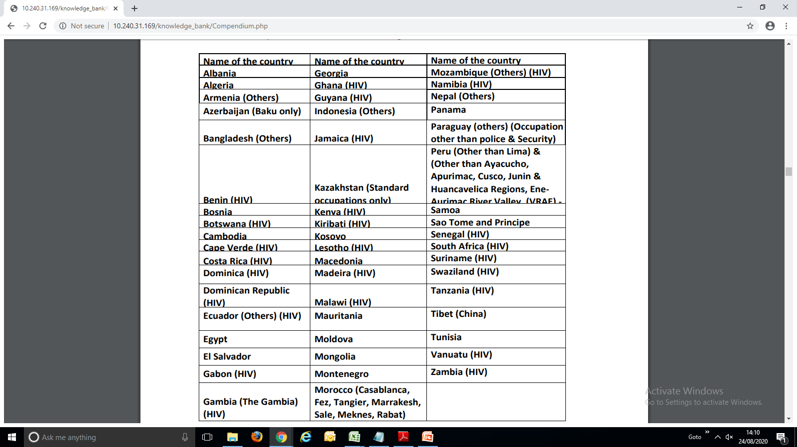
Residence Group IV
NRIs and FNIOs allowed insurance with restrictions
HIV test compulsory in 26 countries

Slide 12
Residence Group IV
Total Insurance Allowed | 250 Lacs
Plans Allowed | All Plans except Pure Term Insurance. Pension plans without life cover to NRIs only
Riders | Only AB Rider Allowed
Residence Extra* | Rs 2%0 (no Res extra for 916, 917, 865 - Option C with sgl prem with Max term 15 Years where ASA is lower than single premium paid & pension plans without life cover)
For cities of Daresalaam, Mwanza, Arusha, Dodoma (Capital), Zanzibar City, Mbeya of TANZANIA no residence extra to be charged.
For cities of Nairobi Metro (incl. Nairobi city), Mombasa, Kisumu, Nakuru, Eldoret of KENYA no residence extra
All other locations in Tanzania and Kenya : Residence extra Rs. 2%0
(CO NBR 189 dt 3/10/2018)

Slide 13
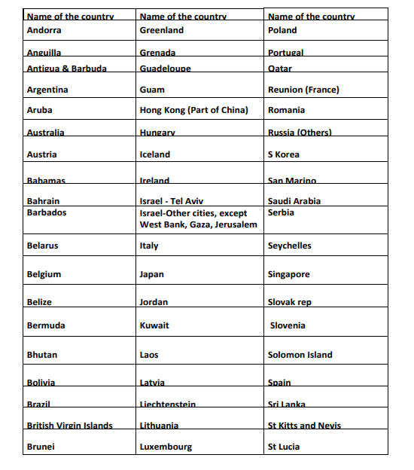
Residence Group V
NRIs and FNIOs allowed insurance with restrictions

Slide 14
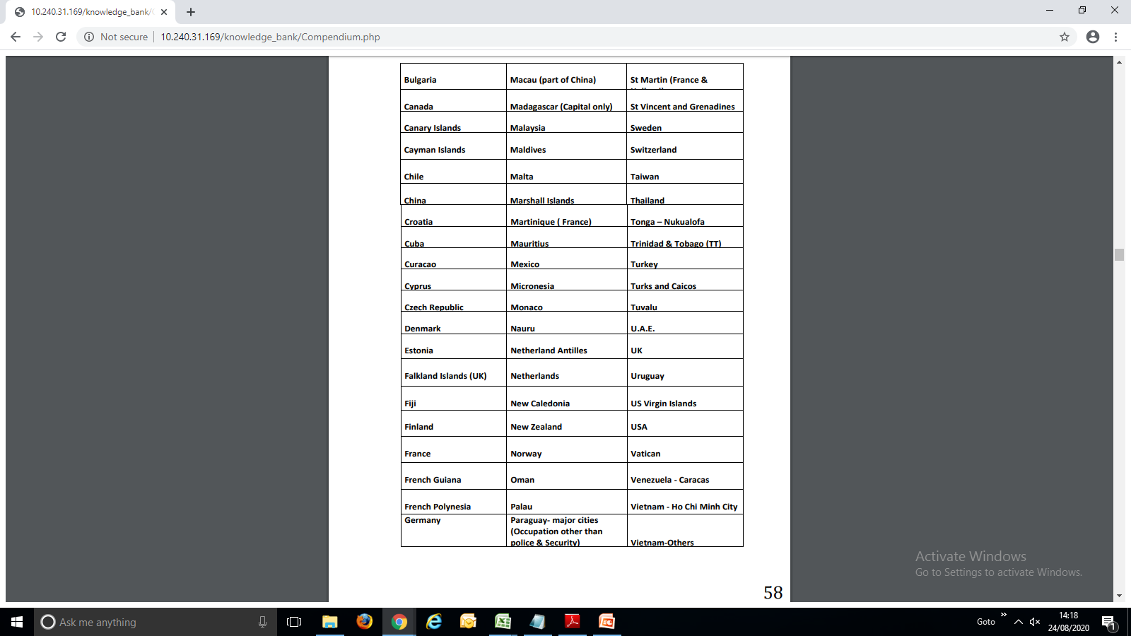
Residence Group V

Slide 15
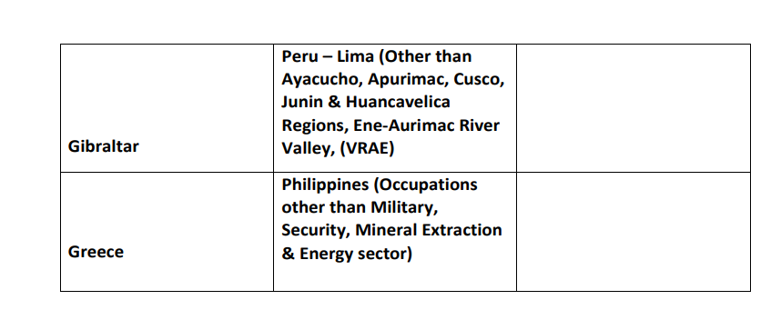
Residence Group V

Slide 16
Residence Group V
Total Insurance Allowed | No Limit (except MOB)
Plans Allowed | All Plans (Pension plans with restrictions)
Maximum Term Allowed | No Restrictions
Riders | AB rider , New Term Rider & PWB Rider (proposal on minor lives)
Residence Extra | Nil
CIR, Cancer cover, Business Insurance | Not allowed

Slide 17
Pension Plans to NRIs and FNIOs
NRIs:
  Immediate Annuity pension products (Sgl prem) :
      Without life cover
      Without limit
      Without residence extra
      To all residence group
FNIOs:
  Immediate Annuity pension products (Sgl prem) :
      Without life cover
      Only to Overseas Citizen of India having OCI Card
      Valid Passport
      Recommendations of Branch in Charge
      Adhering to KYC/AML norms
      Deciding authority is RM(NB&Actl)

Slide 18
Non Medical (Preferred) Scheme to NRIs and FNIOs
Residence Group V only
Employed in Govt/Semi. Govt or reputed commercial firms or professionals - CA, Cost Acct, Engineer(Graduate or Diploma),Architects, Actuaries, Doctor, Lawyer, Teacher, Lecturers, Mgmt/Comp consultant , Data Scientist, LIC Agents(with 5 years service) ,
Allowed only during their visit to India
For NRIs MOB under Non Medical allowed if Agent visits country of residence of proponent
Plans allowed - as per u/w circulars issued for the plan – High risk plans & Term Rider not allowed
Age | NM Preferred MAX SUC (Standard Age Proof is must)
Up to 35 years | 100 Lacs
36 to 45 years | 50 Lacs
46 to 50 years | 20 Lacs

Slide 19
Income Proof
Income tax returns filed in the country of residence
If no tax returns, then copy of employment contract with atleast 3 months salary slips & Bank statement showing credit of salary.
Chartered Accountant certified final accounts of business , Business License etc.
NRIs as well as FNIOs to be treated at par with resident Indians for the purpose of calling for income proof Cir Ref: Actuarial /CUS/2104/4 dated 6th March, 2007.

Slide 20
General Guidelines
HIV report + FMR for all proposals from Res groups III & IV for the countries marked HIV , apart from manual requirements irrespective of Sum Assured
Juvenile lives – Where TRSA exceeds 50 lacs, HIV report mandatory for Res group IV for countries marked with HIV , apart from manual requirements
Insurance to Juvenile lives and housewives – only to Res groups IV & V (subject to conditions of the plan and country of residence )
Residence extra to be rated up according to Plan, Term Proposed and mode of payment (Single or Limited payment)
High SA proposals > 50 lacs only from persons employed in Class I occupations (managerial, skilled, high paying desk job type of employment with proof of employment etc.)
Maximum TRSA for Class II occupations - 50 lacs subject to being skilled labourer and under medical scheme only.
For persons employed in Class II occupations, occ extra if any along with Res extra wherever applicable is to be charged . (Occupation ratings as per Circular ref: NB&R 254 dated 26/05/2020)

Slide 21
General Guidelines
Proposals attracting (OE + Res extra) > Rs 3%o to be regretted as multiple risks involved.
Proponents attracting health extra Class III and above and with Class II occupations are to be regretted
NRIs and FNIOs relocating to India - If staying in India for a period of at least one year and intends to continue staying in India, he/she will be treated on par with resident Indians for the purpose of grant of insurance.
Proposals from residents of Libya, Syria & Ukraine – Postpone till further instructions
Proposals from NRIs and FNIOs residing in countries other than those mentioned under any of the groups (I to V) should be sent to NB&R dept, Central Office for individual consideration.
Period of stay in Group I to IV is more than 3 months in a year, guidelines applicable to that country group to be followed.

Slide 22
General Guidelines
Proposals attracting (OE + Res extra) > Rs 3%o to be regretted as multiple risks involved.
Proponents attracting health extra Class III and above and with Class II occupations are to be regretted
NRIs and FNIOs relocating to India - If staying in India for a period of at least one year and intends to continue staying in India, he/she will be treated on par with resident Indians for the purpose of grant of insurance.
Proposals from residents of Libya, Syria & Ukraine – Postpone till further instructions
Proposals from NRIs and FNIOs residing in countries other than those mentioned under any of the groups (I to V) should be sent to NB&R dept, Central Office for individual consideration.
Period of stay in Group I to IV is more than 3 months in a year, guidelines applicable to that country group to be followed.

Slide 23


